Slide 1
FINANCE
BUSINESS FUNCTION

Slide 2
INTRODUCTION
THE FINANCE FUNCTION
DIGITAL FINANCE
DIGITAL STRATEGY
REFERENCES

Slide 3
INTRODUCTION

Slide 4
SME STATISTICS
61% of employed people work for an SME, while SMEs provides between 52% and 57% of the countrys gross domestic product. These are particularly impressive statistics when one considers that of the 5.98 million SMEs registered with the Companies and Intellectual Property Commission (CIPC), 67% are one-person businesses and don’t create any employment at all.
Research pinpoints some of the major causes of SME failure-and thus areas where help is needed. They include :
lack of management,
financial, marketing and human resources skills.
Faith Ngwenya, technical director at the South African Institute of Professional Accountants (SAIPA),
in a paper presented to The Clute Institutes International Academic Conference held in Bangkok.

Slide 5
SME STATISTICS
Contributing factors, it seems, are:
a limited culture of family businesses,
failure to control business growth and
overemphasis on financial reward.
"Many SMEs don’t access government funding because they simply are ill-informed,"
"But more than money, what they need is training and mentoring to make them sustainable over the long term."
Faith Ngwenya, technical director at the South African Institute of Professional Accountants (SAIPA),
in a paper presented to The Clute Institutes International Academic Conference held in Bangkok.

Slide 6
FINANCE SKILLS NEEDED FOR ENTRPRENEURSHIP
Important financial skills required to improve the financial awareness of organisations :
bookkeeping,
financial statement analysis,
risk analysis,
cash flow analysis,
business environment analysis,
investment management, and
development of project proposals
Poor financial awareness amongst business owners and managers and the lack of knowledge required to judge risks, may, in practice, limit their access to opportunities to achieve very high returns in the business.
Budgets are also often utilised for enterprise surveillance, performance evaluation, strategic development, and decision-making improvement, according to the findings.

Slide 7
ACTIVITY
GROUP ACTIVITY
In your group, discuss with your team members your experiences with online and conventional banking and share suggestions based on your experience
Have a discussion about the emergence of online only banks in South Africa

Slide 8
THE FINANCE FUNCTION

Slide 9
FINANCE FUNCTION
Finance tasks can be at least partially automated, leading to more efficient processes and ultimately leaner and smaller finance organizations
Digitalized finance processes become better and finance is able to elevate the quality of its processes as well as the its relevance to the organization
The modern finance function combines operational and financial data (big data) and uses advanced analytics and AI to enhance business decisions while acting as a service provider for the entire organization.
It turns into an eye-level adviser and partner to business units, guiding them in their decision-making process.
In several organizations, this transformation is already underway and has allowed finance to integrate more strongly with the business while adding more relevance to the output of the function.

Slide 10
IMPORTANCE OF ACCOUNTING RECORDS
A review of the current research body shows that the importance of keeping proper accounting records, the rationales for keeping accounting records, the degree of record-keeping, and the existence of accounting systems maintained by SMEs are known, although minimal accounting skills research is available (Kimanzi and Gamede, 2020). I several small business owners do not understand the value of accounting skills as well as the accounting function, which is often the beginning of business failure
Abuka, Tunga, and Nwandu (2020) stressed the importance of keeping proper account books asit helps small businesses provide details on which to make judgments. The study revealed the absence of sufficient accounting skills to maintain records has led to the closure of certain firms, making it a major problem for business performance (Kimanzi and Gamede, 2020).

Slide 11
DIGITISING FINANCES
“The principles of accounting remain the same, even in the digital age. However, technological trends have the potential to transform accounting. Digital technologies can process data far more quickly and reliably than human beings can. They provide an opportunity to fundamentally redesign many financial procedures and generate added value.” Prof. Dr. Rüdiger Loitz
Overall, 64% of SA SMEs say they believe e-commerce will have a positive impact on their business.
The findings also indicate that SA, by far, is the leader in digitalisation across the MEA region, with more than 90% of companies present on social media and/or having a company website.
More than three-fourths (79%) of SA SMEs surveyed accept online payments, 48% accept cards and 41% accept mobile payments. More than half (61%) experienced no challenges when accepting digital payments.

Slide 12
BUDGETTING
Budgeting is a comprehensive and quantified action plan in preparation for an upcoming accounting period where the purpose of the company is to be accomplished (Zamri, Mansor, and Ab Rahman, 2018).
The aims of the financial objectives are also to set and forecast what will occur in the future, to accomplish the next plan (Cohen, McKay, and Wolfe, 2017).
Budgets are necessary to identify demand growth, cash flow, projected revenue, and cost projections over a long or short time, depending on management expectations (Kimanzi and Gamede, 2020).
Accessing sources of financing, such as banks, stock markets, or other credit providers, is more challenging for SMEs than it is for larger organisations (Schmidt, Mason, Bruwer, and Aspeling, 2017).
Restricted access to finance has therefore been identified as one of the key obstacles to the full realisation of SMEs' capacity (Anton and Bostan, 2017)

Slide 13
FINANCE STRATEGY
A few key financial processes are
planning,
auditing,
organising,
controlling, and
accounting
Financial strategy involves planning the investment of financial resources to meet the organisation objectives and goals over a defined timeline
The finance strategy components include sales forecasts, selling costs, gross profit, admin costs, pre-tax profit, balance sheet, working capital, return on investment, repayment proposal, collateral.

Slide 14
FINANCE STRATEGY
Financial strategy management provides details about when and how much money is needed that includes estimates of future performance relating to sales, profits and loan repayments if applicable. Key questions that must be addressed in financial strategy include
How much will it cost to start-up the business?
How much will it cost to run the venture?
Short term cash needs when revenue is low (revenue & expenses – operations).
Sources of capital (for fixed assets & business expansion, how much & when, investors – equity, loans – debt)

Slide 15
ACTIVITY
GROUP ACTIVITY
In your group, make a list of finance related processes that you use in your business
Conduct a quick Google search to find software tools that could automate some of these processes
Select a software application that you believe will assist your business best and share with the team an overview of the tool and why you have selected it

Slide 16
DIGITAL FINANCE

Slide 17
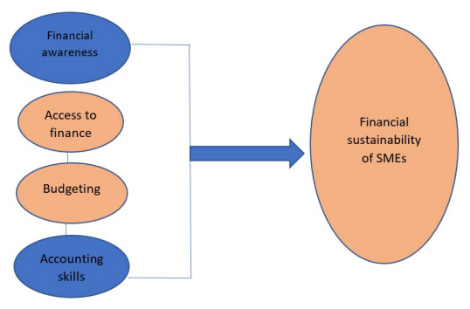
BUSINESS MODEL

Slide 18
FINANCE DIGITAL TOOLS
In most scenarios, the SME accounting role has been limited to laborious data capture and annual meetings between the accountant and business owner to hand over reports and financial statements.
African SME market has been dominated by a few popular products, such as Sage, QuickBooks, and Xero.com, particularly in South Africa.
This is changing fast, thanks to the emergence of advanced cloud computing technology and accessible software-as-a-service (SaaS) accounting solutions
“The Fourth Industrial Revolution is set to have a major impact on the way SMEs operate and manage their finances,” said Arthur Goldstuck, managing director of World Wide Worx, a South African IT consultancy. “Cloud computing in particular is rapidly changing financial management already. We believe that SaaS and its associated tools will have a massive, positive impact on costs and efficiencies within accounting for SMEs.”

Slide 19
FINANCE DIGITAL TOOLS
QuickBooks is an accounting software package developed and marketed by Intuit. QuickBooks products are geared mainly toward small and medium-sized businesses and offer on-premises accounting applications as well as cloud-based versions that accept business payments, manage and pay bills, and payroll functions.
Kissflow is a cloud-based service platform that lets business users create, model, and deploy business process apps without the need for coding using a visual editor. Suitable for key finance capabilities to go digital that includes purchase request, purchase order, vendor onboarding, staff mileage reimbursement, expense claim, and timesheet management.
Zoho finance plus is a pay-as-you-go service that offers comprehensive, end-to-end integrated platform, double-entry accounting software for managing business finance that includes invoicing, inventory, accounting, automatic payment reminders, accept online payments, and more from a united platform.
Xero is a cloud-based accounting software platform for small- and medium-sized businesses. The xero tool is suitable to manage invoices, bank reconciliation, inventory, purchasing, expenses, bookkeeping, and more.

Slide 20
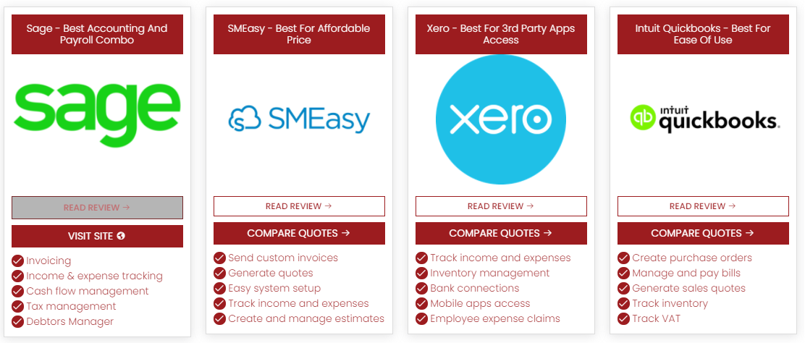
BUSINESS MODEL

Slide 21
FINANCE DIGITAL TOOLS
“Gone are the days when clients and accountants kept separate sets of books and collaborated yearly to discuss financial statements,” said Shapiro. “The value of the cloud is to collaborate with clients in the cloud, by accessing the same set of accounting records and sharing information freely with each other.” Graham Shapiro, founder of Myccountant, a provider of virtual accounting solutions in South Africa
It was concluded that SME owners need more accounting training or bookkeeping awareness. This is because training will equip SME owners with the needed skills to ensure accurate recording of business transactions, which is beneficial when the need for financial assistance from banks or other financial institution arises.
Accounting Skills and the Sustainability of Small and Medium Enterprises in South Africa
April 2021
Thabiso Msomi
Odunayo Magret Olarewaju

Slide 22
FEATURES OF DIGITAL ACCOUNTING
Data capture/entry—
simplify and automate the data entry to the software
scan or take a photo of an invoice or receipt and send it to an app which reads it and inserts the data to the software
software can link to the business bank account(s) including credit cards and automatically import the data to the software.
saves time and reduces the likelihood of errors.
Automation features—
creating rules for certain transactions e.g. take regular payments such as rent and post them to the rent expense account.
software learns the names and tries to match e.g. supplier invoices to payments made to the supplier and same with customers.
set reminders to chase outstanding debtors etc.

Slide 23
FEATURES OF DIGITAL ACCOUNTING
Open API—
Application Programming Interface is the method by which the software packages share data or communicate with each other.
data can be shared between apps.
the till system in a shop can feed all its data into the accounting system or the EPOS system can feed in or the credit card machine etc.
accounting system can feed its data into a cashflow forecasting system to constantly update and reforecast.
Xero has hundreds of apps which can be used alongside it.
SME’s can integrate a lot more of their functions, share and make better use of the data.
see, review, monitor and extract that data.
live links the data is always updated and up to date

Slide 24
BENEFITS OF DIGITAL FINANCE
Single source of truth—
one set of data - ‘single source of truth’.
no multiple backups i.e. one live used by client an older version used by the accountant.
Better back up and disaster recovery—
The cloud system provider ensures the data is constantly backed up and stored in multiple locations.
SME’s back up and disaster recovery plans aren’t as good as those run by specialist organisations.
data is constantly backed up so it is unlikely any data would ever be lost
In the event of a disaster or failure in the SME’s computer systems, you can simply access the data from an alternative location or computer.

Slide 25
BENEFITS OF DIGITAL FINANCE
Can access anywhere and on any device—
access the cloud data from any web browser with an internet connection.
dedicated smart phone/tablet apps for ease of any device.
useful to check information on the go.
while heading to meet a customer and you can check whether their bills have been paid or how much they spent with you last year etc.
New features, updates, security are all rolled out automatically and regularly—
software company issues the new updates including security features constantly.
no need for new discs or to download and install updates or to upgrade each year.
security is much better than that operated by most SMEs.

Slide 26
DIGITAL STRATEGY

Slide 27
DIGITAL STRATEGY
More than three-fourths (79%) of SA SMEs surveyed accept online payments, 48% accept cards and 41% accept mobile payments. More than half (61%) experienced no challenges when accepting digital payments.
According to the OECD, up to 70% of SMEs globally have intensified their use of digital technologies since the onset of Covid-19. However, the gaps in SME digital adoption have not been filled. The challenges include access to infrastructure, lack of a data culture and digital awareness, and financing gaps for transformation costs

Slide 28
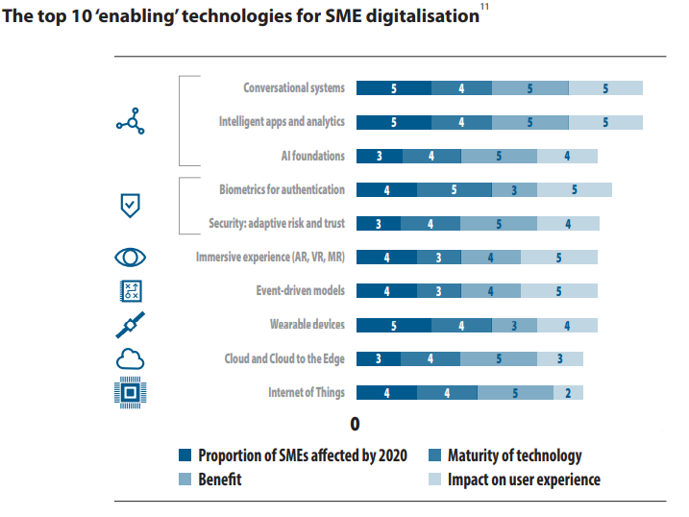

Slide 29
MY ASSETS
How does your business do its bookkeeping?
Do you currently use any software to do your books?
If so, what system are you using?
Does the performance of your financial operations impact on your business?
Do you find many errors in payments, collections or accounting recording?
Would you say that time or knowledge is the biggest issue impacting your accounting ?
Have you ever investigated free online accounting tools?
Would training on using accounting software be useful to your business?

Slide 30
ACTIVITY
GROUP ACTIVITY
In your group, identify how a digital transformation would impact on your businesses?

Slide 31
REFERENCES

Slide 32
REFERENCES
1. Mission Vision Goals and Objectives Mission Vision Goals and Objectives | Digital E-Learning (digitalelearnings.com)
2.10 Business Strategy Examples (And Why It’s Important to Have One.
https://www.indeed.com/career-advice/career-development/business-strategy-examples
3. Drivers of digital adoption: a multiple case analysis among low and high-tech industries in Malaysia https://www.emerald.com/insight/1757-4323.htm
4. Key business drivers– major impact on business performance: managing–must factors: value, growth, innovation, cost https://bizshifts-trends.com/key-business-driver-major-impact-business-performance-managing-value-innovation-growth-sustainability
5. The 7 Principles of Digital Business Strategy & Transformation (slideshare.net)
6. 5 Major Reasons Your Business Needs A Digital Strategy http://blog.actuatedigital.co.ke/2016/09/01/why-your-business-needs-a-digital-strategy/
7. Digital Readiness Assessment: The First Step Toward a Future-Ready Workforce https://blog.mettl.com/digital-readiness/
8. Change Made in Shop Floor Management to Transform a Conventional Production System into an “Industry 4.0” http://dx.doi.org/10.1109/ICITM.2018.8333919

